Slide 1
Radiology RPT Information Session
RPT for 2025 – 2026
Reappointment, Promotion, and Tenure
Jill McMahon, Radiology RPT Chair
  Provide feedback & advice on materials & process
Taylor Pillar, Department RPT Administrative Support Person
  Receives documents, contacts referees, provides feedback on process, final packet assembly
Notes:
Ask: Current rank, system (FT,HP,TS) and college

Slide 2
Goals for this Session
Share information with department faculty
Host open conversation about promotion

Slide 3
Words of Wisdom
Look at the college specific guidelines/criteria as a first step
Use correct Form on Progress and Excellence (P&E)
Eloquent self-promotion is required
  Team efforts are commendable, BUT highlight how YOUR role made a difference
Review a successful promotion packet from a recent candidate
Curated summaries of accomplishments in the academic portfolio give context and meaning.
Ask for feedback (colleague, RPT member, etc.)
Some forms of excellence could fit into more than one category
    At your discretion
    Consider: Integration across Multiple Mission Functions (Form on P&E)

Slide 4
RPT and your appointment type
Appointment Types
Tenure System (TS)
Fixed Term (FT)
Health Programs (HP)
Clinical /Adjunct Non-prefix
Adjunct / Pre-fix
Research
Academic Specialist
RPT Processes
Reappointment & Tenure (TS Only)
Promotion – similar process for all tracks with some variations

Slide 5
Promotion Criteria
TS and FT non-Clinical faculty
Teaching
Scholarly Activity and Research
Service and Outreach
HP and Clinical FT faculty
Patient Care Services
Clinical and Preclinical Teaching
Scholarly Productivity and Research
Institutional Service
CHM RPT Guidelines
COM RPT Guidelines
Radiology Department Guidelines

Slide 6
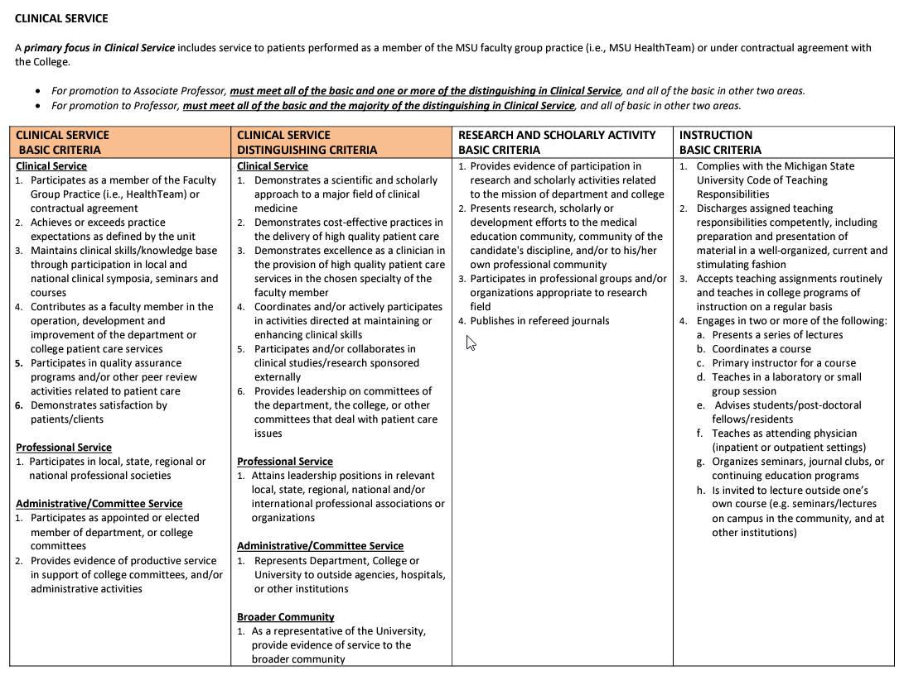
Sample of CHM Promotion Criteria
CHM RPT Guidelines
  Found under Resources
CHM FT Clinical Criteria
CHM TS Criteria

Slide 7
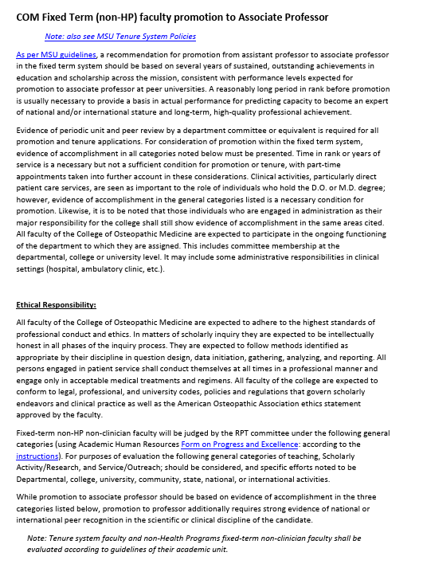
Sample of COM Promotion Criteria
COM RPT Guides

Slide 8
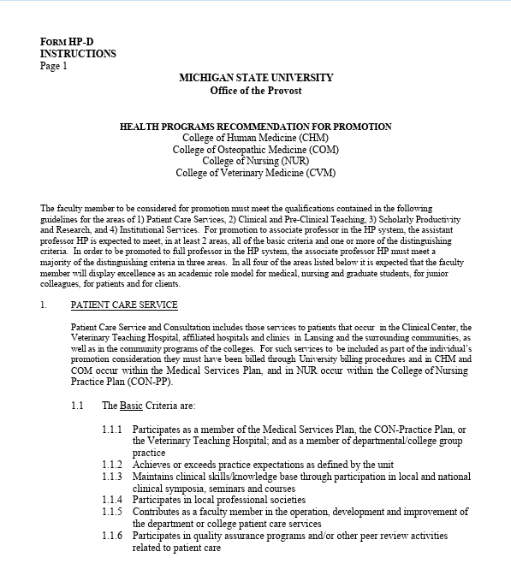
Sample of HP Promotion Criteria

Slide 9
The Promotion Dossier
Promotion Form on Progress and Excellence (30-50 p)
Reflective Essay (5 p)
Curriculum Vitae (15-30 p)
External Reviewers / Letters (15 p)
Annual Reviews (25-30 p)
COVID-19 Impact Statement (optional)
Academic Portfolio (375p upper limit; <300 p better goal, <200p even better)
Maximum of 500 pages
Strongly advise against long portfolio!!
Notes:
For CHM, get the form D off the website. Others

Slide 10
Promotion Form on Progress & Excellence:
Appointment details, committee votes, reviewer information
Summary Information (Chair and Dean evaluation)
Summary Evaluation - detailed (Chair evaluation)
Detailed Reporting from candidate
  Instruction
  Research and Creative Activities
  Academic Service
  Clinical Service
Notes:
For CHM, get the form D off the website. Others use the university versions.

Slide 11
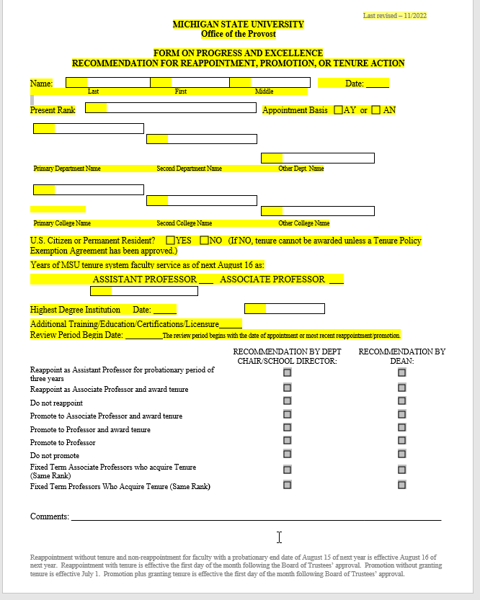
TS Promotion Form: Page 1
Candidate should fill out upper portion
If appointed with % effort in multiple colleges, notify Radiology RPT Committee
Notes:
For CHM, get the form D off the website. Others

Slide 12
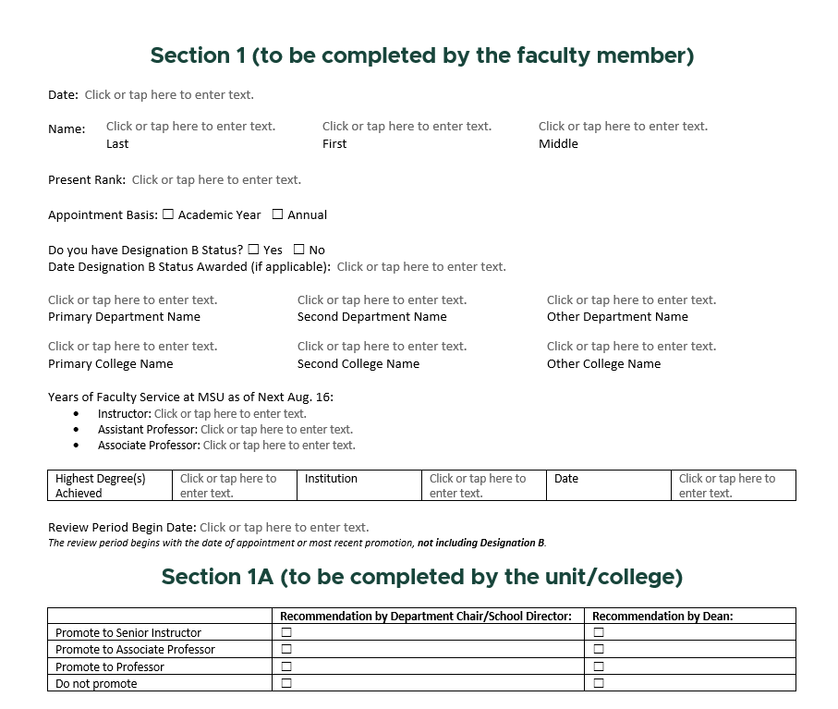
FT Promotion Form: Page 1
Form for FT – revised March 2025
If appointed with % effort in multiple colleges, notify Radiology RPT Committee

Slide 13
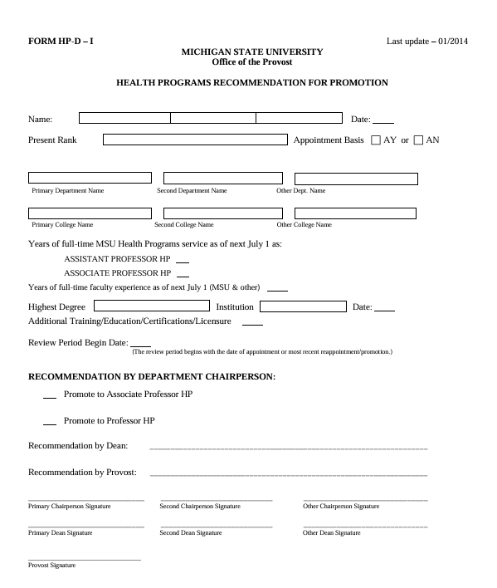
HP Promotion Form: Page 1
Candidate should fill out upper portion
If appointed with % effort in multiple colleges, notify Radiology RPT Committee

Slide 14
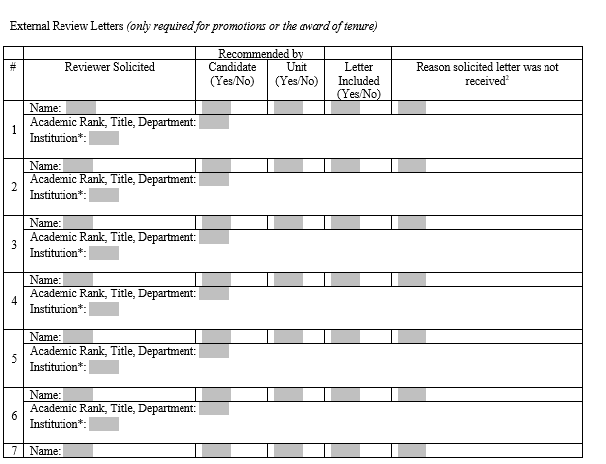
Promotion Form: Review Letters
LEAVE BLANK!
RPT Staff: complete this page.
Candidate: Email LIST of potential reviewers to Radiology RPT Committee.
Notes:
For CHM, get the form D off the website. Others

Slide 15
Promotion Form :Candidate should fill out assignment of time
(TS)
Function | Sub-Functions | Assignment% of Time | Excellent | Very Good | Avg. | Below Avg. | Poor
INSTRUCTION | Undergraduate*
 | Graduate*
 | Non-Credit Instruction
 | Academic Advising
RESEARCH & CREATIVE ACTIVITIES | Research & Creative Activities
SERVICE | Academic: Within Scholarly and Professional Organizations
 | Academic: Within the University
 | Within the Broader Community:
OTHER | Other (specify)
OVERALL RATING |  | 100%
Notes:
For CHM, get the form D off the website. Others

Slide 16
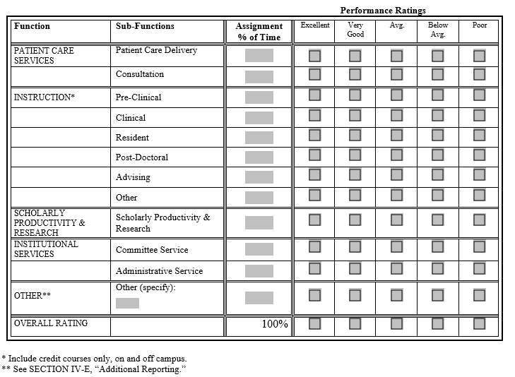
HP and Clinical Promotion Form :Candidate should fill out assignment of time

Slide 17
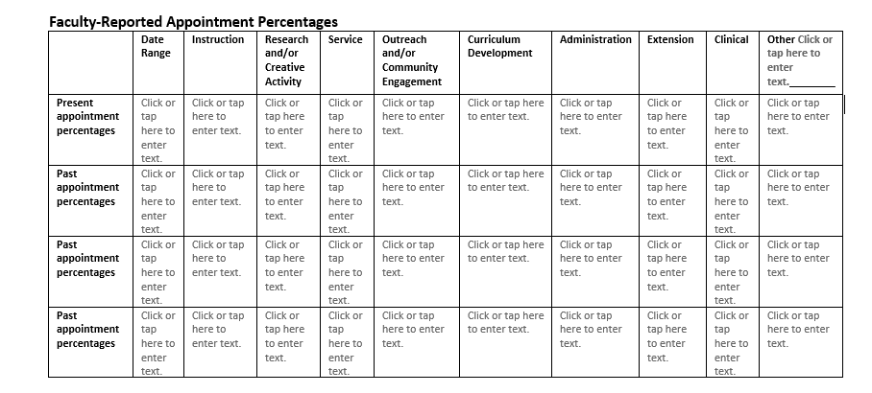
FT Promotion Form:
Candidate should fill out assignment of time
Notes:
For CHM, get the form D off the website. Others

Slide 18
Promotion Form Candidate Sections
Fill out pages completely
Emphasize impact and significance throughout
Refer evaluators to portfolio
FEEL FREE to provide brief excerpts or statements in Form on P&E including a summary of artifacts
Explain significance / impact of a particular award or recognition
Notes:
For CHM, get the form D off the website. Others

Slide 19
Annual Reviews
Will be added in by Department

Slide 20
Reflective Essay (self-evaluation)
Describes your journey in academia as a narrative
Highlights how your accomplishments are significant & impactful
Highlights how you have contributed to the university mission
Describes how you embody excellence
Can include future impact and direction to demonstrate upward trajectory
Teaching statement
Up to 5 pages in length (3-5 recommended)
Avoid listing and repeating your CV

Slide 21
Diversity, Equity, and Inclusion
Updates are in progress. Take credit for your efforts in this area.
2024 RECOMMENDATIONS
Consistent with MSU Values and the Strategic Plan, a lens of DEI is integrated into the RPT review processes.
The university has issued:
Recommendations for Writing and Evaluating Diversity, Equity, and Inclusion (DEI) in the Faculty Annual Review and Reappointment, Promotion, and Tenure (RPT) Process Council of Diversity Deans (CODD).
The Faculty Handbook on RPT also includes a section on DEI
In accordance, CHM committees have endorsed:
A guidance document for addressing diversity, equity and inclusion in RPT deliberations
A companion document that includes examples of activities that could be used as evidence of contributions to diversity, equity and inclusion in RPT dossiers.

Slide 22
MSU Policy External Letters
MSU External Letter Policy
Letters from leading scholars at peer institutions (Big 10) or similar
All external letters of reference solicited and received are included (limited to 6 for CHM)
If referee fails to or declines to submit a letter, this information shall become part of the packet
Solicitation is done through the Chair / Director Office
Candidate may not contact these referees
Minimum of 4 letters
  Selected from candidate list and Chair’s list
  More specific qualifications vary slightly by college, appointment system and rank
  Can be someone you do not know, but can relate to your specialization

Slide 23
List of (External) Referees: Requirements
Professionally capable of assessing the candidate’s work objectively and comment on significance in the discipline
  Academic rank, at or above candidate’s desired rank
  Available time to write a comprehensive review
  In no case should this be a major advisor, especially research related
  Limit colleagues you have collaborated with extensively (multiple co-authored papers, within your MSU dept, Residency director, etc).
Ideal Referees
  Collaborator from professional committee
  Publish similar works
  Work in similar field, similar clinical focus or discipline
  Work in a collaborating department (FT, HP)

Slide 24
List of Referees: Departmental Process
Candidate creates a list of 8 adequate scholars
Candidate sends the top 6 of list in order of preference
  To: RAD RPT Committee leaders / chairs and directors: Taylor Pillar / Dr. Delano or Dr. McCollum (Div. of Anatomy) / Jill McMahon
  Details: Name, Title, Institution, Department, email, etc.
  Include website link to share this with us
Chair/director will need to also have their own selected referees, be strategic in your list

Slide 25
Letters of Reference: ADDITIONAL
Additional letters solicited directly by candidate
  Collaborators from MSU
  Outside clinical collaborator that cannot fully address all promotion criteria
  Outreach site
  Instructor team
Include in academic portfolio

Slide 26
Letters of Reference
Materials needed for External Review
Effort % / Position Description
Reflective Essay
CV
Samples of Scholarly Work (if applicable)
Evidence of teaching excellence (with major teaching role)
Updated Department directory webpage
RECOMMEND TO LOOK AT THE CRITERIA REVIEWERS WILL BE USING TO ASSESS YOUR CANDIDACY

Slide 27
COVID-19 Statement
Optional
MSU Statements on COVID-19
Impact on productivity, invited lectures/conferences, engagement

Slide 28
Academic Portfolio
Organized documentation of your work
Summary of evidence
Evidence
  abstracts, conference proceedings
  awards, emails, publication front page
  excerpts, citations from others
  notes of appreciation
  candidate solicited letters
  any type of publication
Helpful tips
  Indexed / Bookmarked
  Highlight as needed, your name etc.
  Provide enough to show evidence
Regardless of your college (CHM or COM) use the CHM requirements for the template
  1-2 brief paragraphs summarizing your case that the criterion is met
  Titles of the artifacts that support your case in order
CHM has specific guidance for each appointment type & focus
COM has more latitude in what constitutes excellence / metrics
  COM candidates use CHM portfolio structure & modify the categories to make your case for promotion

Slide 29
Academic Portfolio: TEACHING EVALS
  CHM guidance
  Latitude on what is reported
  Do not have to include every remark in the review period
  Select comments that show excellence over the review period (not just one course from one year)
  Tables, flow charts, or graphs can be created to showcase performance. These might be useful to copy up into the Form P&E.
  Teaching excellence also can be from other sources aside from student evals.
  Professional evaluations from colleagues or emails or award/nominations/recommendations can be used.
  Somebody adopting your teaching style or syllabus or lecture, etc.

Slide 30
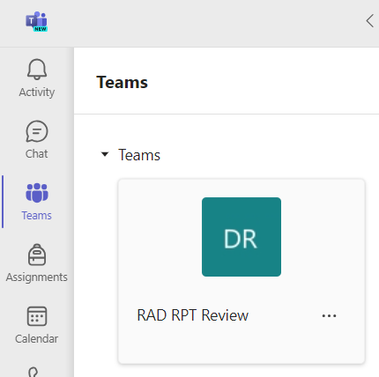
Submitting Your Materials
Upload documents to your Microsoft Teams folder
    Access through Teams app or by using MSU netID and password to log in to Office 365
Notify Taylor Pillar (jollifft@msu.edu) and Jill McMahon (jslade@msu.edu) via email or Teams message once you’ve uploaded a new document

Slide 31
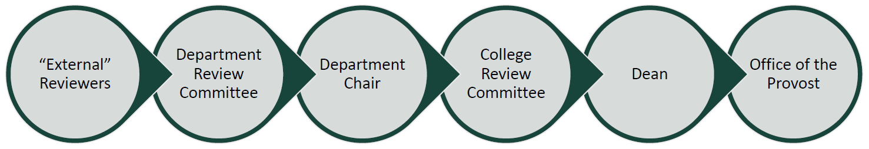
The Review Process
External referees evaluate evidence & makes recommendation
Department review committee evaluates evidence & makes recommendation to Chair / Director
Chair / Director reviews and makes recommendation to the Dean
Department administrator submits materials to College RPT Committee
College RPT Committee reviews and makes recommendation to Dean
Dean reviews and makes recommendation to Provost
Provost reviews and approves/disapproves

Slide 32
Radiology Department RPT Timeline
June 1, 2025
HP and FT faculty candidates notify the Committee of their candidacy.
June 16, 2025
Submit a list of referees (min 6).
July 16, 2025
Submit materials for referees.
October 1, 2025
Tenure system (TS) faculty: will be notified by the department.
Complete dossiers due to the department.
CV, Reflective Essay, Scholarly sample(s), Effort.
Effort.
Oct – Dec, 2025: Department-level reviews
Jan – Feb, 2026: College-level reviews
Mar – Apr, 2026: Provost/EVP Review
May, 2026: Notification of provost decision
June – July 2026: BOT final approval for TS decisions
Notes:
(Reappointments do not require letters of reference) TS

Slide 33
Resources
The Office of Faculty and Academic Staff Development (OFSAD, formerly the Academic Advancement Network)
Academic Career Path Events archive
Faculty Guide for Reappointment, Promotion, and Tenure Review
CHM RPT Guides
COM RPT Guides
College Mentoring Programs: COM CHM
Radiology RPT Teams page for declared candidates
Provost Statement on Faculty Tenure and Promotion

Slide 34
Next steps for upcoming promotion cycle
Notify department you are applying – 6/1/25 deadline
  Email Taylor Pillar and Jill McMahon
  jollifft@msu.edu, jslade@msu.edu
Referee list – 6/16/25
  6 professional reviewers
  Face pages of Form on Progress & Excellence
Documents for referees – 7/16/25

Slide 35
Common Pitfalls in RPT
Reflective essay not integrative, vision and significance absent
Not enough information for comprehensive review by referees
Leaving sections of Promotion Form blank
Incomplete sections of Promotion Form (providing a list, but no details)
Tables filled out incorrectly
Lack of ideal professional references
Limited documentation of evidence
Starting promotion process late
Limited scholarly activity
Disorganized and/or ineffective Academic Portfolio
Questions??

