Slide 1
Radiology RPT Information Session
RPT for 2023 – 2024
Reappointment, Promotion, and Tenure
Jill McMahon, Associate Professor with Tenure, Radiology RPT Chair, COM RPT Committee Member
Taylor Pillar (Radiology) Josh Vincent (Anatomy) & Kevin DiPiazza (Research faculty), Primary Department RPT Administrative Support

Slide 2
Radiology RPT Committee and Staff Support
Committee
Jill McMahon, PhD
Committee Chair
Associate Professor with Tenure
Melanie McCollum, PhD
Professor, Fixed Term
Erik Shapiro, PhD
Professor with Tenure
Jie Huang, PhD
Professor, Fixed Term
Frances Kennedy, PhD
Professor, Fixed Term
Administrative Support
Taylor Pillar
Unit HR Administrator
Josh Vincent
Office Supervisor
Kevin DiPiazza
Administrative Business Analyst

Slide 3
Goals for this Session
Share information with department faculty
Host open conversation about promotion

Slide 4
RPT and your appointment type
Appointment Types
Tenure System
Fixed Term
Health Programs
Adjunct and Clinical Adjunct
Research
RPT Processes
Reappointment & Tenure (TS Only)
Promotion – similar process for all tracks with some variations

Slide 5
Promotion Criteria
Tenure System (TS) and Fixed Term (FT) non-Clinical faculty
Teaching
Scholarly Activity and Research
Service and Outreach
Health Programs (HP) and Clinical Fixed Term (FT) faculty
Patient Care Services
Clinical and Preclinical Teaching
Scholarly Productivity and Research
Institutional Service

Slide 6
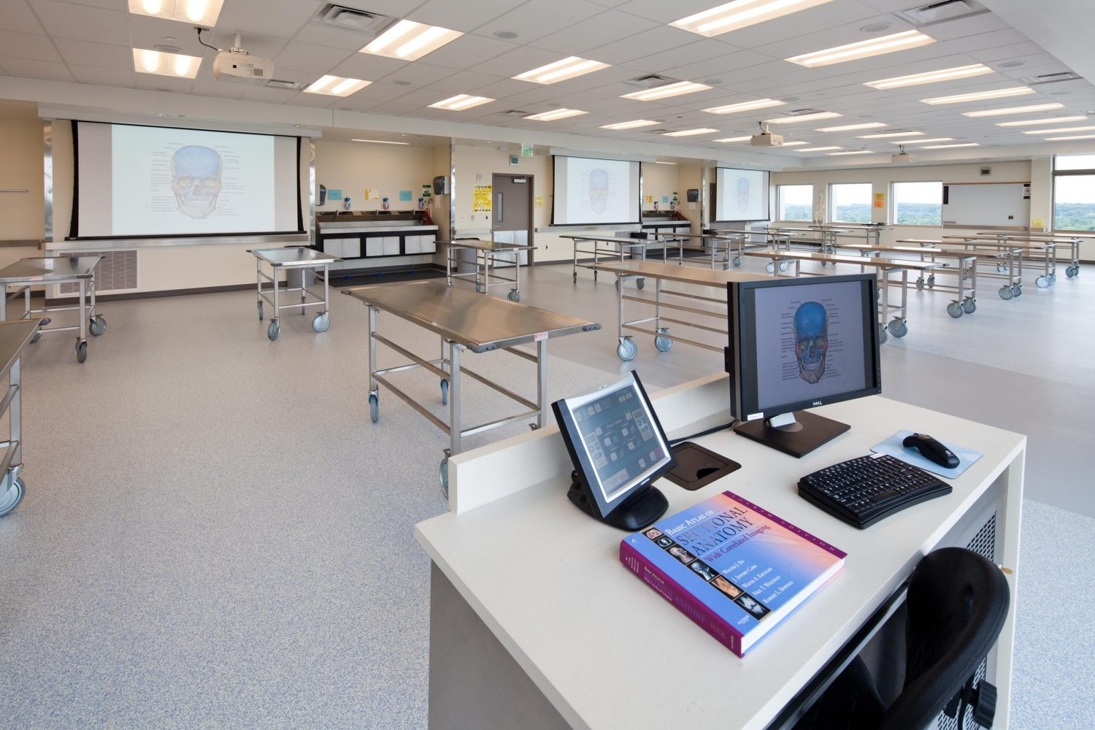
Teaching
Pre-clinical teaching
Clinical teaching (clerks, interns, residents, fellows)
Other teaching (undergraduate, graduate, postgraduate, CME, lifelong learning)
Advising or mentoring
Is assessed to be an effective teacher by colleagues and other faculty

Slide 7
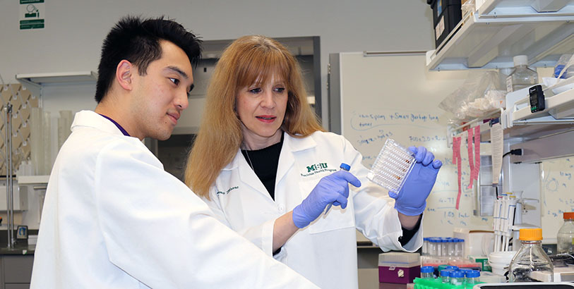
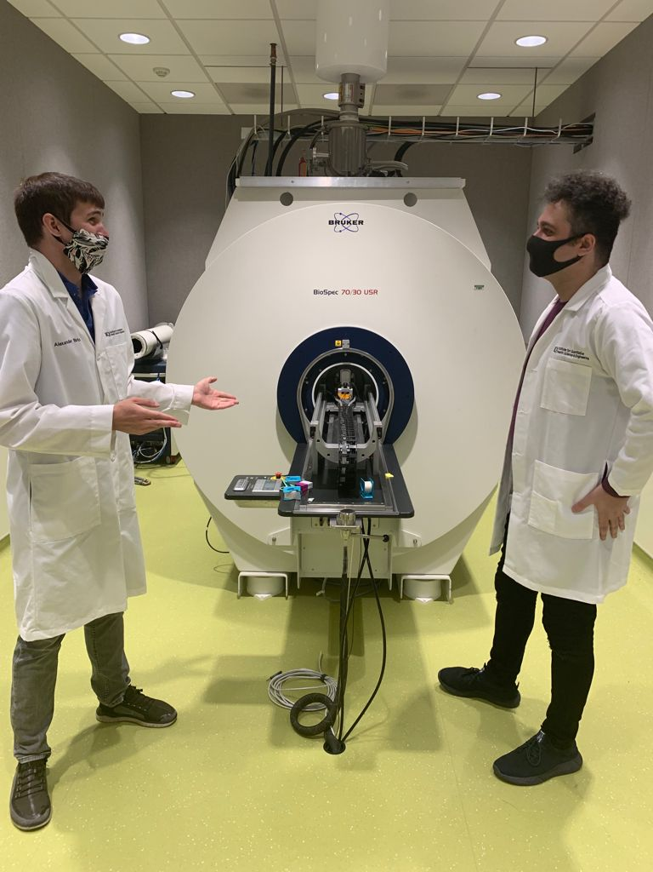
Scholarly Activity and Research
Basic research
Clinical research
Theoretical or other scholarly activities
Med Education
Development & submission of research proposals
Impact to discipline

Slide 8
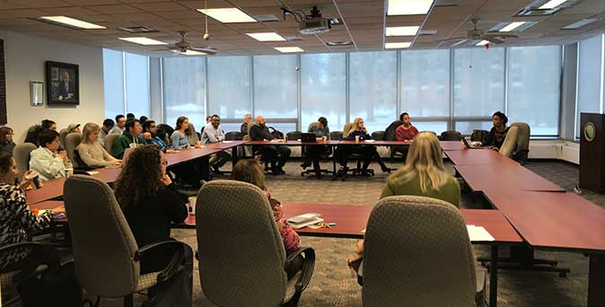
Service and Outreach
Departmental, college, university, community, state, national, and international activities
Committee membership or leadership, program development, consultation
Academic service as editor or reviewer of a journal, grant reviewer
Institutional Service: Provides evidence of productive service in support of college committees and/or administrative activities
Outreach: Provides evidence of service to the broader community as a representative of the university

Slide 9
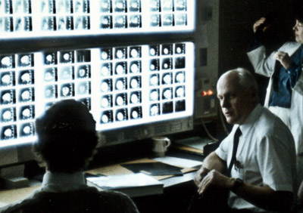
Patient Care
Clinical and clinically related activities at the college, university, community, state, national, or international level
Patient Care Service and Consultation includes those services to patients that occur in MSU HealthCare Facilities, affiliated hospitals and clinics in Lansing and the surrounding communities, as well as in the community programs of the colleges
Patient Care: Demonstrates Excellence as a clinician in the provision of high-quality patient care services in the chosen specialty of the faculty member

Slide 10
The Promotion Dossier
Form on Progress and Excellence (Form D): CORRECT FORM
Effort / Position Description
Reflective Essay
Curriculum Vitae
External Reviewers / Letters
Annual Reviews
COVID-19 Impact Statement (optional)
Academic Portfolio
Maximum of 500 pages
Notes:
For CHM, get the form D off the website. Others

Slide 11
Form on Progress and Excellence (Form D): 4 Parts (I-IV)
Part I: Appointment details, committee votes, reviewer information
Part II: Summary Information (Chair and Dean evaluation)
Part III: Summary Evaluation - detailed (Chair evaluation)
Part IV: Detailed Reporting from candidate
A: Instruction
B: Research and Creative Activities
C: Service
D: Additional Reporting
Notes:
For CHM, get the form D off the website. Others

Slide 12
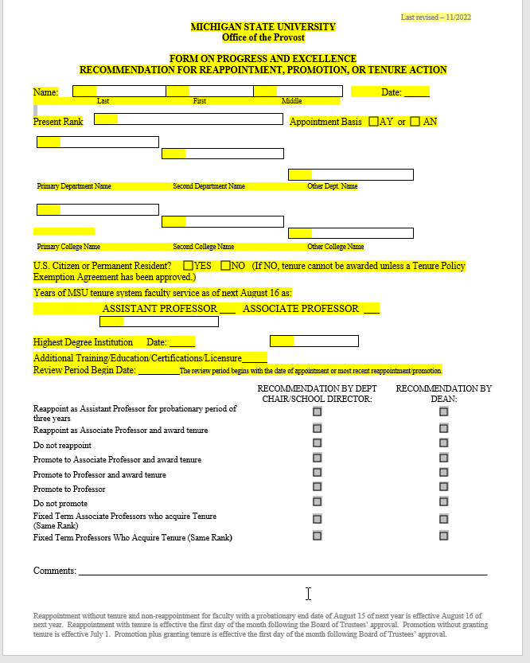
Form on Progress and Excellence (Form D): Face Page: Page 1
Candidate should fill out upper portion
Notes:
For CHM, get the form D off the website. Others

Slide 13
CHM Form for FT

Slide 14
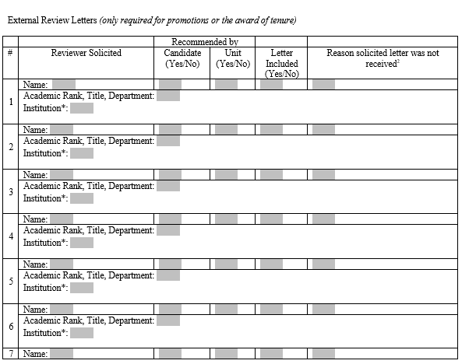
Form on Progress and Excellence (Form D): Section IA Page: Pg 2
Provide list of external referees / reviewers to department only, do not fill out on the form.
Notes:
For CHM, get the form D off the website. Others

Slide 15
Form on Progress and Excellence (Form D): Section II Candidate should fill out assignment of time
Function | Sub-Functions | Assignment% of Time | Excellent | Very Good | Avg. | Below Avg. | Poor
INSTRUCTION | Undergraduate*
 | Graduate*
 | Non-Credit Instruction
 | Academic Advising
RESEARCH & CREATIVE ACTIVITIES | Research & Creative Activities
SERVICE | Academic: Within Scholarly and Professional Organizations
 | Academic: Within the University
 | Within the Broader Community:
OTHER | Other (specify)
OVERALL RATING |  | 100%
Notes:
For CHM, get the form D off the website. Others

Slide 16
Form on Progress and Excellence (Form D): Section IV: Pg. 10-18
Fill out pages completely
Emphasize impact and significance throughout
Refer evaluators to portfolio AND provide brief excerpts or statements
Explain significance/impact of a particular award or recognition
Part IV: Detailed Reporting from candidate
A: Instruction
B: Research and Creative Activities
C: Service
D: Additional Reporting
Notes:
For CHM, get the form D off the website. Others

Slide 17
Presenting Your Case
Academic Portfolio
Purpose: Provide evidence that you meet the review criteria
Audience: Department and College level review committees and administrators
Organization: Bookmarked PDF collection of documents, ordered by the areas and criteria of review
Summary: Reflective Essay and COVID-19 Statement
Qualitative: Academic Portfolio
Quantitative: Form on P&E and CV
Your Case for Promotion
Reflective Essay
Highlight how your accomplishments in research, creative activities, teaching, and service are significant and impactful and have contributed to the university mission, describe how you embody excellence.
Reflective Essay
Not an echo of your CV!
Max
5 pages

Slide 18
MSU Policy External Letters
https://hr.msu.edu/policies-procedures/faculty-academic-staff/faculty-handbook/external_ref-letters.html
External letters of reference should be from leading scholars at peer institutions (Big 10) *
All external letters of reference solicited and received must be included in the review materials.
If an external letter of reference is solicited and the referee fails to or declines to submit a letter of evaluation, this information shall become part of the candidate's review materials.

Slide 19
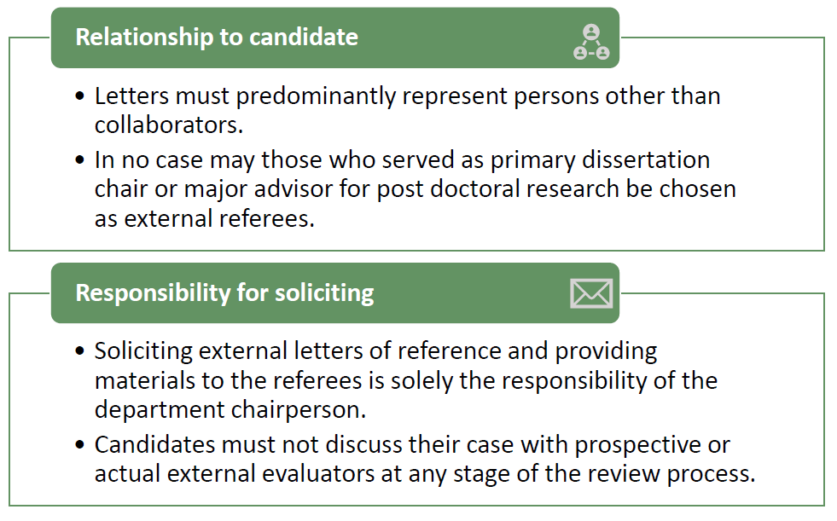
Letters of Reference: EXTERNAL
Provide evidence that candidate has achievements and performance level that is comparable with faculty at peer institutions
Professionally capable of assessing the candidate’s work objectively and to comment on its significance in the discipline or specialty area
Minimum of 4 letters
Selected from candidate list and Chair’s list
External Reviewer qualifications vary slightly by college, appointments system and rank

Slide 20
Letters of Reference Materials needed for External Review
Effort / Position Description
Reflective Essay
Curriculum Vitae
Samples of Scholarly Work (if applicable)
List of Potential Reviewers

Slide 21
Letters of Reference: ADDITIONAL
Additional letters solicited directly by candidate
Collaborators from MSU
Outside clinical collaborator that cannot fully address all promotion criteria
Outreach site
Instructor team
Include in academic portfolio

Slide 22
Academic Portfolio
Evidence (abstracts, conference proceedings, awards, emails, publication front page, excerpts, citations from others, any type of publication)
Summary and organization of evidence
Highlights of relevance (when needed)
College Requirements: CHM
CHM has specific guidance on how to set this up (20-33 pages)
Specific to focus (instruction, clinical, research, admin service)
1-2 brief paragraphs summarizing your case that the criterion is met
Titles of the artifacts that support your case in order
College Recommendation: COM
Organize by category and subcategory of your liking
Structure consistent with promotion packet Form
Descriptor face pages recommended (scaled down version of CHM requirements)

Slide 23
Annual Reviews
Serve as a critical piece of evidence of accomplishment and impact!
Department has moved to more specific process for annual review
Will be added in by Department
Counts toward 500-page limit

Slide 24
Diversity, Equity, and Inclusion
Consistent with MSU Values and the Strategic Plan, a lens of DEI is integrated into the RPT review processes.
The university has issued:
Recommendations for Writing and Evaluating Diversity, Equity, and Inclusion (DEI) in the Faculty Annual Review and Reappointment, Promotion, and Tenure (RPT) Process Council of Diversity Deans (CODD).
The Faculty Handbook on RPT also includes a section on DEI
In accordance, CHM committees have endorsed:
A guidance document for addressing diversity, equity and inclusion in RPT deliberations
A companion document that includes examples of activities that could be used as evidence of contributions to diversity, equity and inclusion in RPT dossiers.

Slide 25
The Review Process
Faculty member assembles evidence
Department review committee reviews criteria for the appointment system and the dossier of evidence
Department review committee makes recommendation to chair
Department administrator reviews and submits materials to College RPT Committee
College RPT Committee reviews and makes recommendation to Dean
For paid faculty, Dean reviews and makes recommendation to Provost
Provost reviews and approves/disapproves

Slide 26
Radiology Department RPT Timeline
June 30, 2023
HP and FT faculty candidates notify the Committee of their candidacy.
June 30, 2023
Promotion candidates submit a list of referees (min 6). (Reappointments do not require letters of reference)
August 1, 2023
Promotion candidates submit materials for referees.
October 1, 2023
Tenure system (TS) faculty: will be notified by the department.
Complete dossiers due to the department.
CV, Reflective Essay, Scholarly sample(s), Effort.
Oct – Dec, 2023: Department-level reviews
Jan – Feb, 2024: College-level reviews
Mar – Apr, 2024: Provost/EVP Review
May, 2024: Notification of provost/EVP decision
June – July 2024: BOT final approval for TS decisions

Slide 27
Resources
The Office of Faculty and Academic Staff Development (OFSAD, formerly the Academic Advancement Network)
Academic Career Path Events archive
Faculty Guide for Reappointment, Promotion, and Tenure Review
CHM RPT Guides
COM RPT Guides
College Mentoring Programs: COM CHM
Radiology RPT Teams page for declared candidates

Slide 28
Reappointment and Tenure (Tenure System Only)
Provost Statement on Faculty Tenure and Promotion

Slide 29
The Promotion Dossier
Form on Progress and Excellence (Form D): CORRECT FORM
Effort / Position Description
Reflective Essay
Curriculum Vitae
External Reviewers / Letters
Annual Reviews
COVID-19 Impact Statement (optional)
Academic Portfolio
Maximum of 500 pages
Notes:
For CHM, get the form D off the website. Others

Slide 30
Common Pitfalls in RPT
Reflective essay not integrative, vision and significance absent
Leaving sections of form D blank
Lack of professional references
Limited documentation, start early!
Starting late
Tables filled out incorrectly
Note that time in service is not equal to evidence for promotion
Limited scholarly activity

